Slide 1

SMART LIGHTING SYSTEM
PRESENTED BY:
Kshama G

Slide 2
Table of Contents
Overview
Software Platform
Components Used
Component Description
Circuit Design
Code
Working of the Project
Applications

Slide 3
Overview:
Smart lighting is a technology designed for energy efficiency, convenience and security.
This may include high efficiency fixtures and automated controls that make adjustments based on conditions such as occupancy.

Slide 4
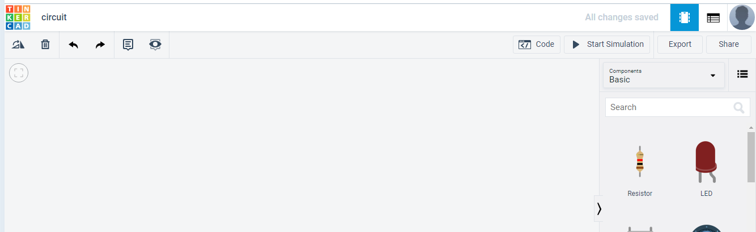
Software Platform:
TINKERCAD:
Tinkercad is a free, online circuit designing platform that runs in a web browser, known for its simplicity and ease of use.

Slide 5
COMPONENTS:
Arduino(UNO)
PIR sensor
Photoresistor
Breadboard
LED
LCD
Resistor

Slide 6
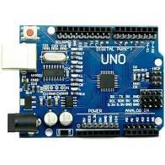
ARDUINO :
Arduino is an open-source electronics platform
The board has 14 digital I/O pins, 6 analog I/O pins.
It can be powered by the USB cable or by an external battery ranging from 7 to 20 volts.

Slide 7
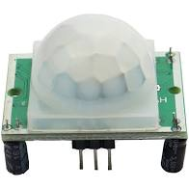
PIR SENSOR :
A passive infrared sensor(PIR sensor) is an electronic sensor that measures infrared(IR) light radiating from objects in its field of view.
A PIR based motion detector is used to sense movement of people, animals, or any other objects.

Slide 8
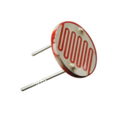
PHOTORESISTOR:
A photoresistor (acronymed LDR for Light Decreasing Resistance, or Light-Dependent Resistor) is a passive component that decreases resistance with respect to receiving luminosity (light) on the component's sensitive surface.

Slide 9
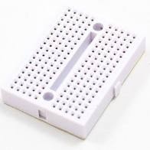
BREADBOARD :
A breadboard is a construction base for prototyping of electronics.

Slide 10
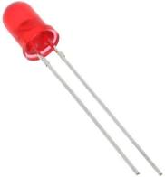
LED :
•A Light Emitting Diode is a semiconductor light source that emits light when current flows through it.

Slide 11
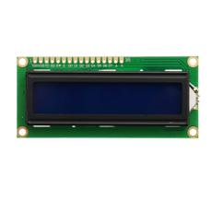
LCD DISPLAY:
●LCDs are available to display arbitrary images (as in a general-purpose computer display) or fixed images with low information content

Slide 12
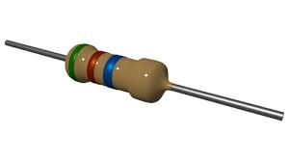
RESISTOR :
Resistors are used to reduce current flow, adjust signals levels, to divide voltages,bias active elements, etc.

Slide 13
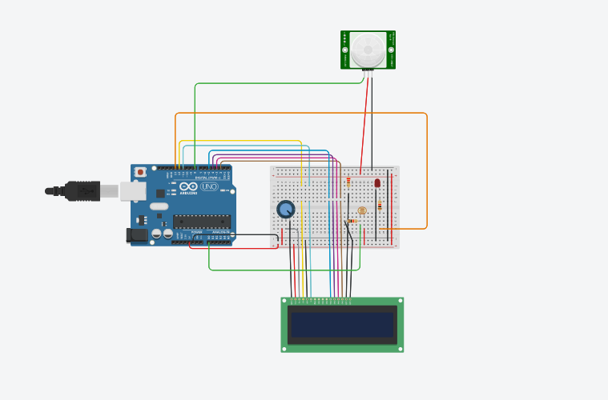
CIRCUIT DESIGN :

Slide 14
CODE :
#include <LiquidCrystal.h>
#define led 13
#define Pir 8
LiquidCrystal lcd(12,11,5,4,3,2);
void setup()
{
pinMode(led, OUTPUT);
pinMode (Pir, INPUT);
lcd.begin(16, 2);
}
void loop()
{
int ldr=analogRead(A0);
int pir=digitalRead(Pir);
if(ldr<100 && pir==HIGH)
{
digitalWrite(led,HIGH);
lcd.println("obj detected");
delay(1000);
lcd.clear();
}

Slide 15
else
{
digitalWrite(led,LOW);
lcd.println("obj not detected");
delay(1000);
lcd.clear();
}
if(!(ldr<100) && pir==HIGH)
{
digitalWrite(led,LOW);
lcd.println("obj detected");
delay(1000);
lcd.clear();
}
else
{
digitalWrite(led,LOW);
lcd.println("obj not detected");
delay(1000);
lcd.clear();
}
}

Slide 16
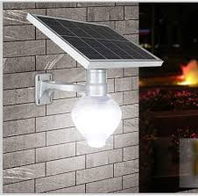
Working :
Turns ON when the sensor detects movement of humans at night.
Doesn’t turn ON when the sensor detects movement of humans in the daylight.

Slide 17

ADVANTAGES:
Reduced electricity bill
Save energy resources
Enhance Security System

Slide 18
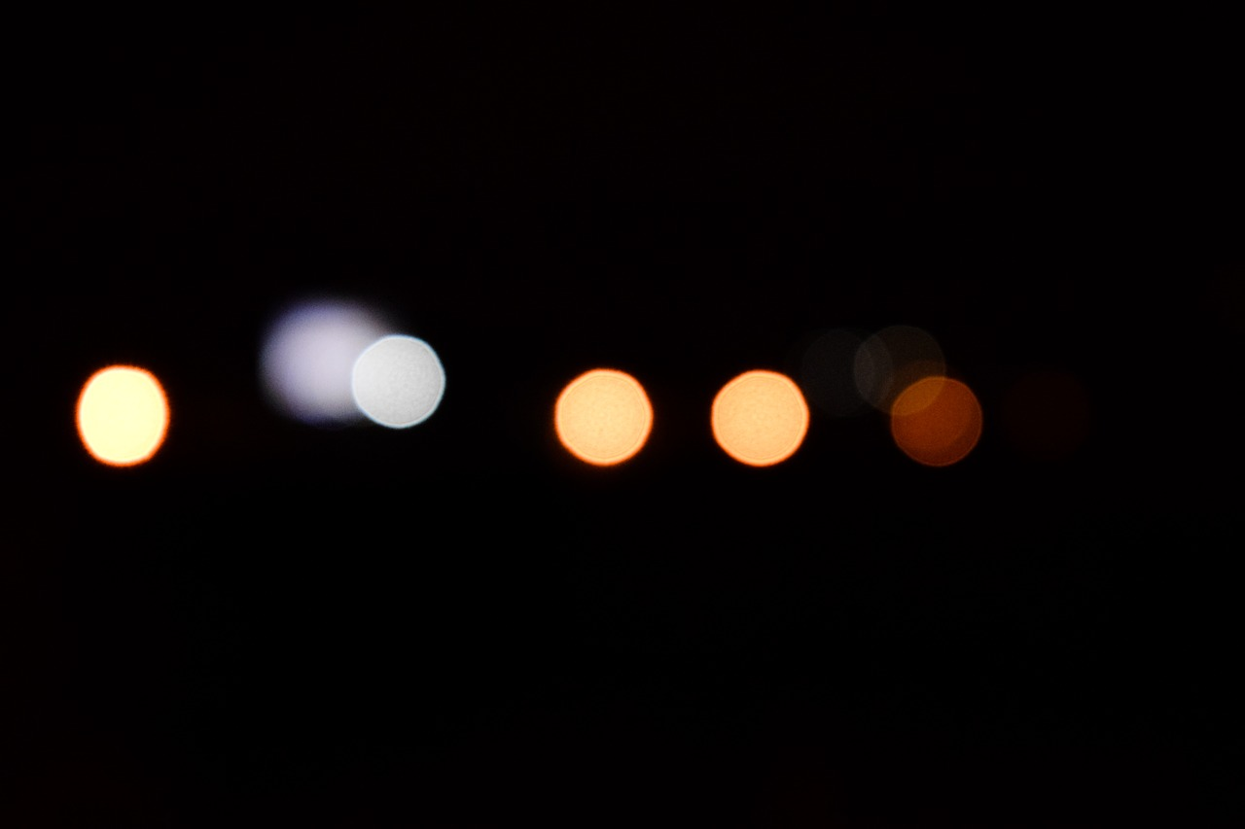
APPLICATIONS :
Garage Lights
Bathroom Lights
Staircase Lights
Security Lights
Street Lights

Slide 19
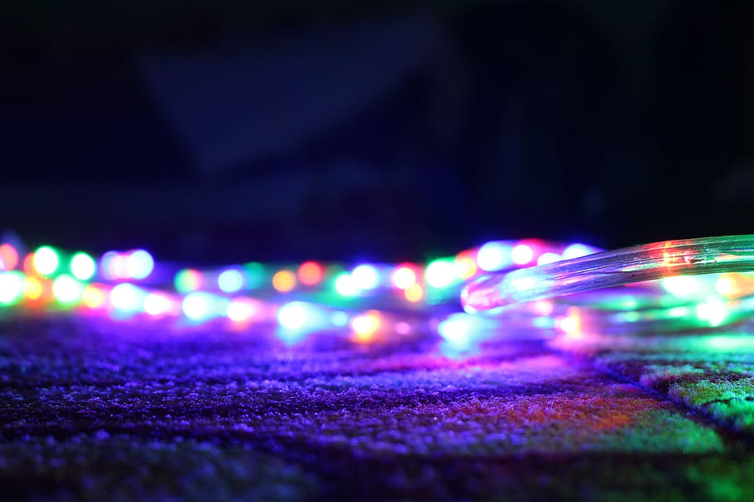
THANK YOU

